Slide 1


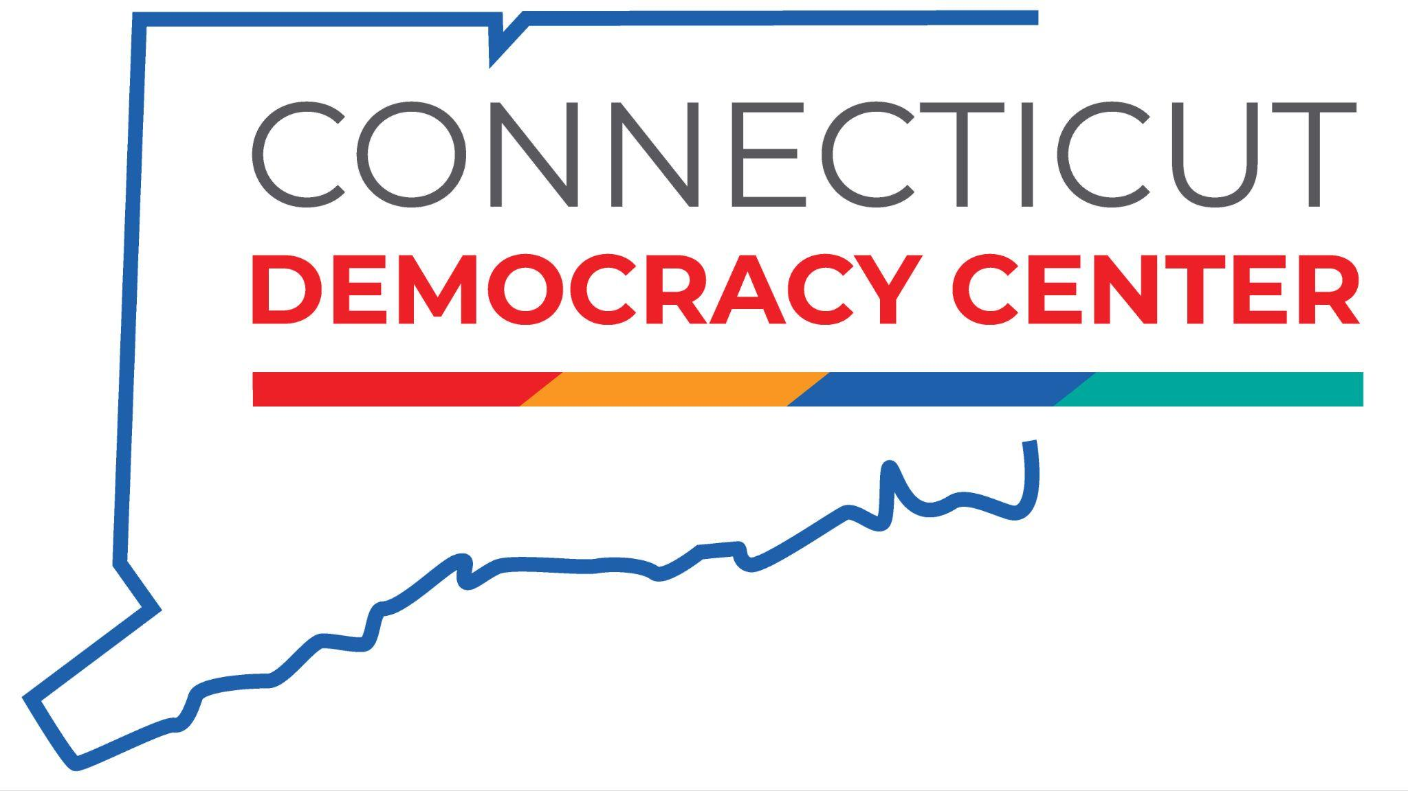

National History DayⓇ, Connecticut History Day & Library of Congress
History is More Than Words!
Ms. Sharon Gillette,
Program Manager

Slide 2
Agenda
Time | Goal
8:45-9:00 am | Arrival & Coffee
9:00-9:30 | Welcome & Introductions
9:30-11:00 | Image Analysis Activities
11:00-11:15 | Break
11:15-12:00 | Searching the Library of Congress Database
12:00-1:30 | Lunch & Museum Visit
1:30-2:45 | Connecticut’s Tobacco Industry
2:45-3:45 | You Be the Curator: Incorporating Images in Historical Arguments
3:45-4:00 | Questions & Exit Survey
Materials: https://tinyurl.com/CT-PD-2026

Slide 3

Welcome
Sally Whipple
Executive Director, Connecticut Democracy Center at Connecticut’s Old State House

Slide 4



Slide 5
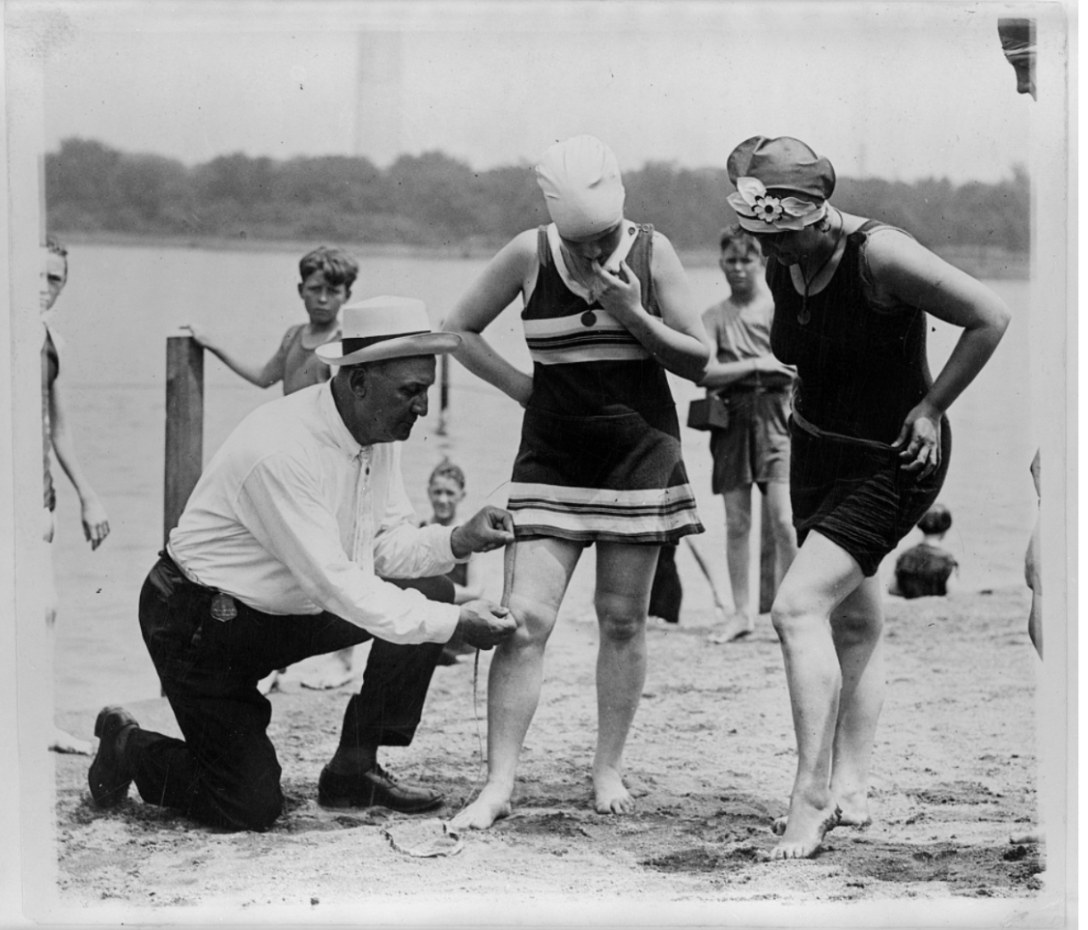
Image Analysis Strategy 1

Slide 6
Col. Sherrell, Supt. of Public Buildings and Grounds, has issued an order that bathing suits at the Washington bathing beach must not be over six inches above the knee.
Washington D.C, 1922.
https://www.loc.gov/item/90708909/.

Slide 7
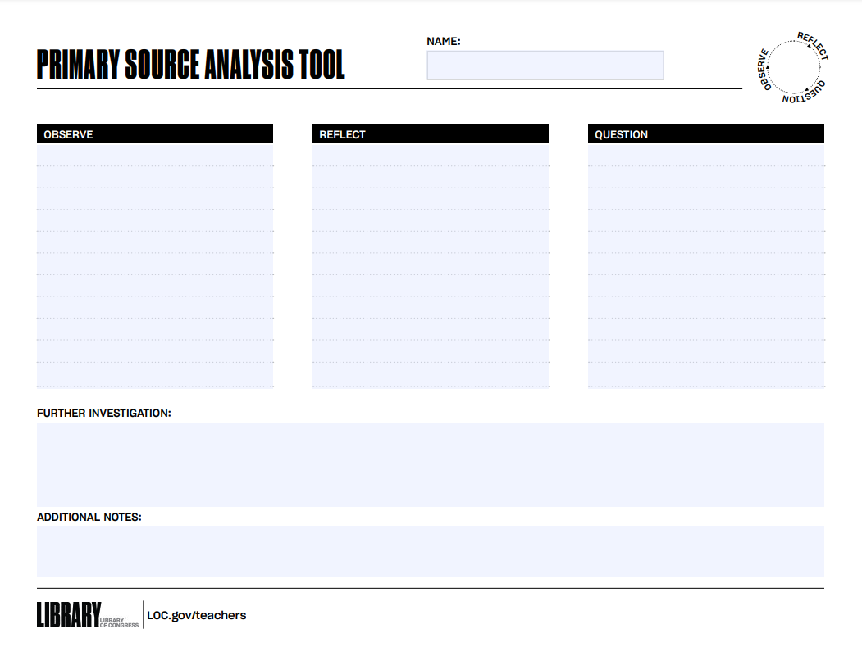
Image Analysis Strategy 2
SEE
THINK
WONDER

Slide 8
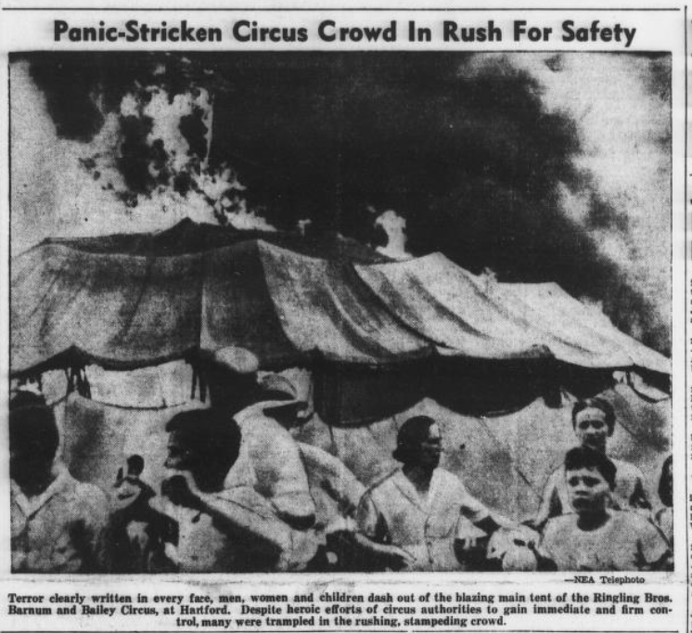
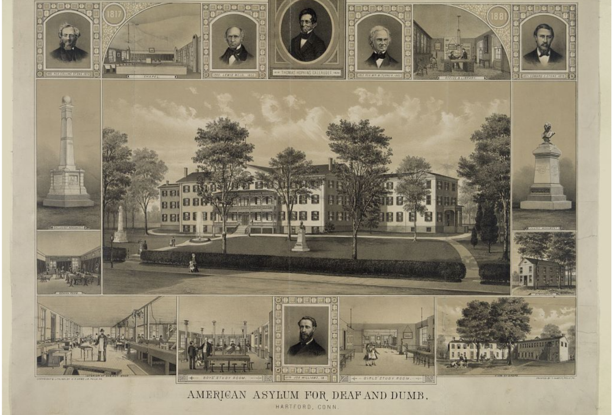
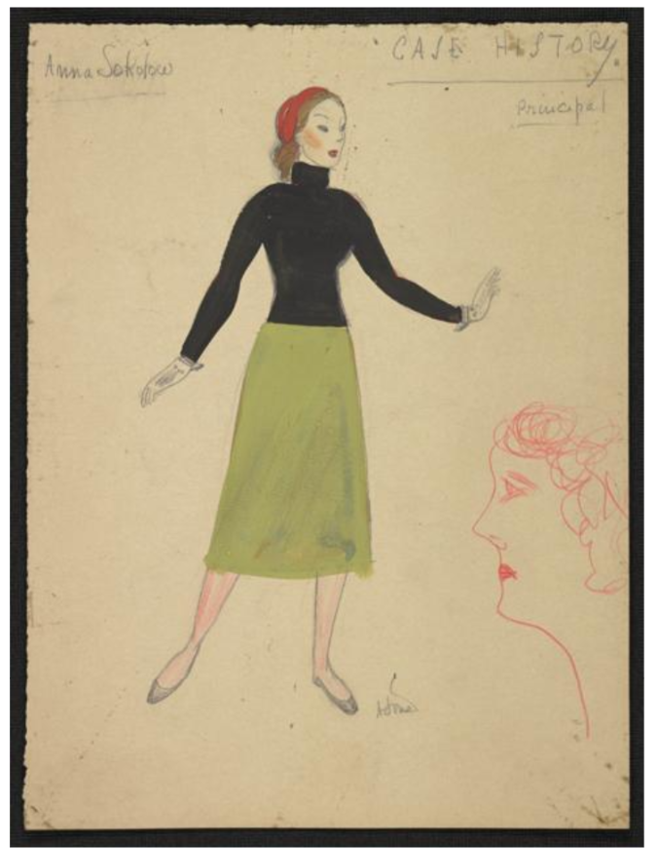
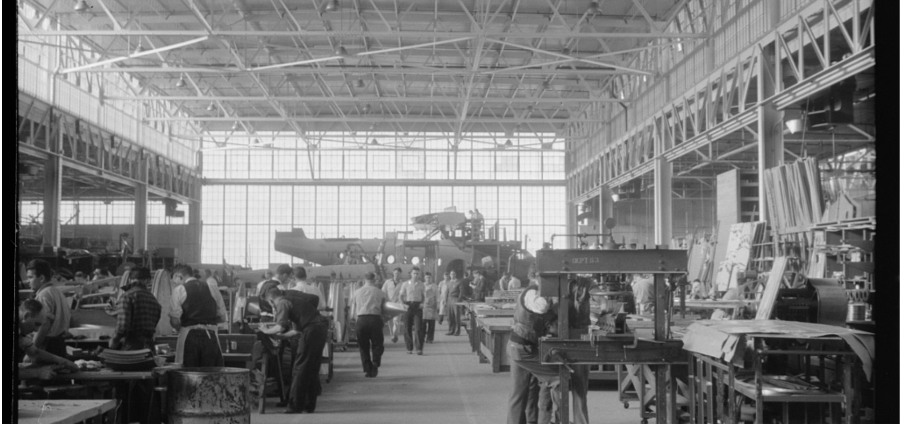
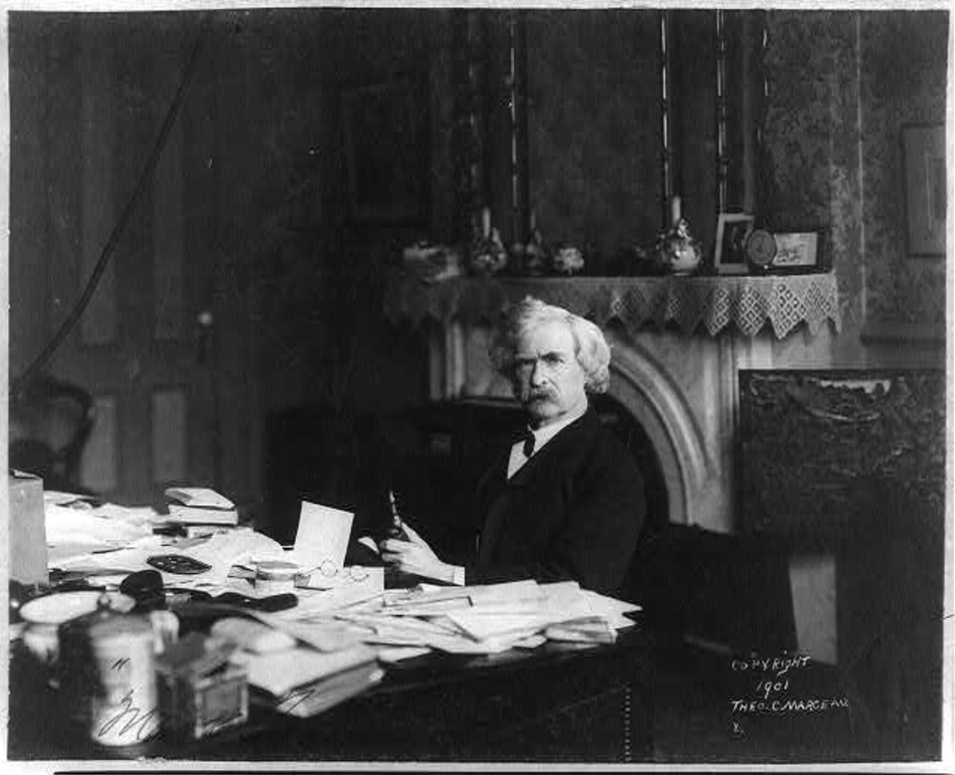
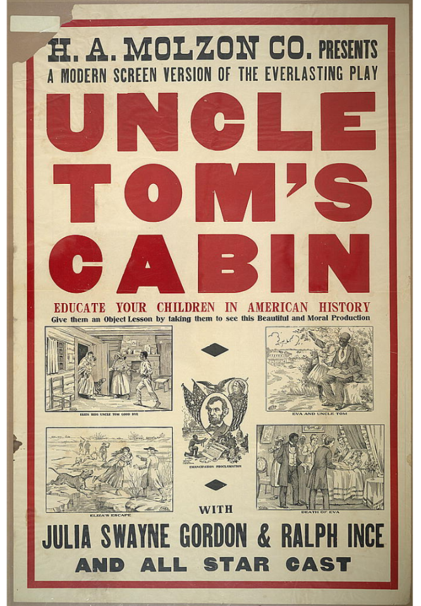
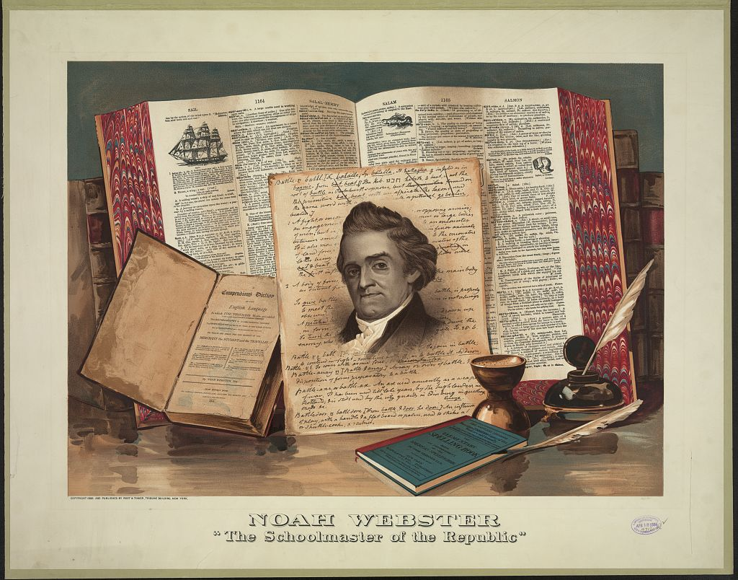
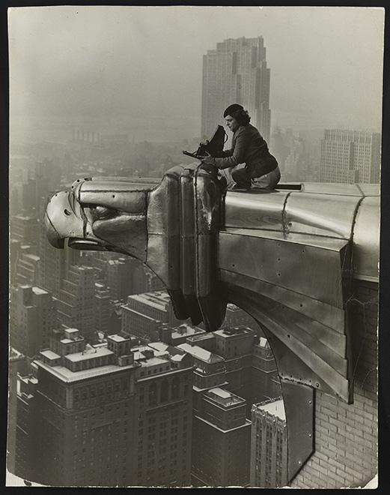
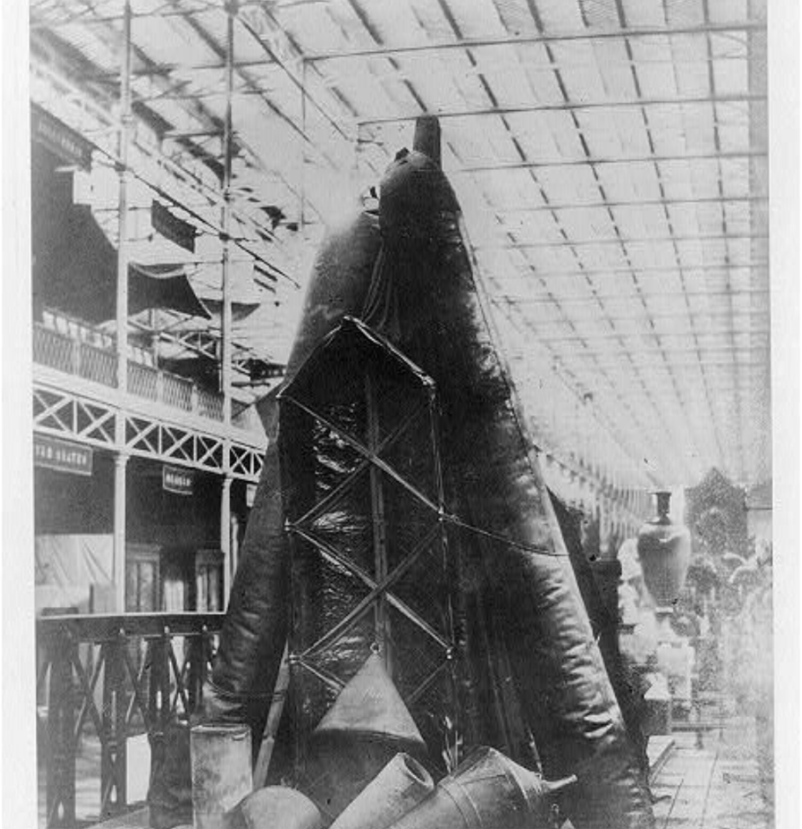
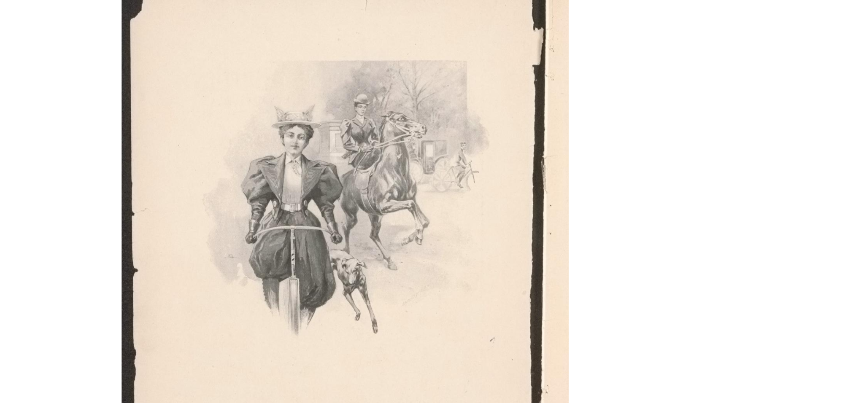
Image Analysis Activity

Slide 9
What do you see / observe?
Observations we can generally agree on.
Look closely at the details.
“I think ____ because _______.”
What do you think is going on in this image?
What questions does this image generate?
Make 2-3 connections to Connecticut history and the idea of innovation in history

Slide 10
Pope Manufacturing Company (periodical)
Columbia Bicycles
1895
https://www.loc.gov/item/07003454/

Slide 11
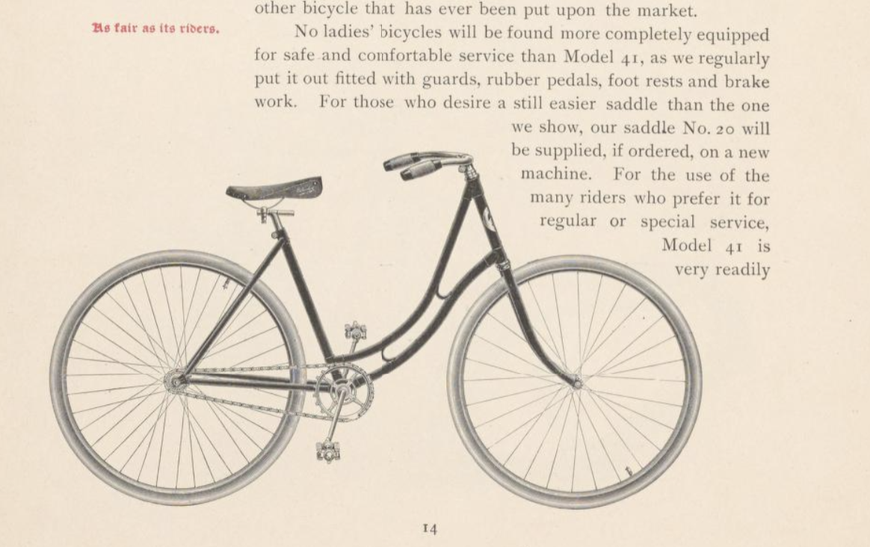

Slide 12
H. A. Molzon presents a modern screen version of the everlasting play Uncle Tom's cabin with Julia Swayne Gordon & Ralph Ince.
1910
https://www.loc.gov/item/2015645293/

Slide 13
Hiram P Arms
American Asylum for Deaf and Dumb, Hartford, Conn. ca. 1881
https://www.loc.gov/item/2004670330/.

Slide 14
Indian Rubber Boat, Pontoons, & C.
1851
https://www.loc.gov/item/2012646366/

Slide 15
Jack Delano
General view of one of the factory floors of the Vought-Sikorsky Aircraft Corporation, Stratford, Connecticut. United States Stratford Connecticut Nov. 1940
https://www.loc.gov/item/2017748370/.

Slide 16
Oscar Graubner
Margaret Bourke-White atop the Chrysler Building. New York, ca. 1930
https://www.loc.gov/item/2011660317/.

Slide 17
Noah Webster. Born -died 1843. The schoolmaster of the republic, ca. 1891. Dec. 19.
https://www.loc.gov/item/2003680691/.

Slide 18
The Waterbury Democrat. (Waterbury, CT), Jul. 7 1944J.
https://www.loc.gov/item/sn82014085/1944-07-07/ed-1/.

Slide 19
Mark Twain. , ca. 1901.
https://www.loc.gov/item/2018664550/.

Slide 20
Federal Theatre Project, U.S. Case History: Principal Anna Sokolow. Black turtleneck, green skirt, and red headscarf, 1934.
https://www.loc.gov/item/musihas.200218564/.

Slide 21

Break!
11:00-11:15
Materials: https://tinyurl.com/CT-PD-2026

Slide 22
Searching the Library of Congress database - shortcuts
Primary Source Sets -
https://www.loc.gov/classroom-materials/?fa=partof_type:primary+source+set
Free to Use and Reuse - https://www.loc.gov/free-to-use/
Research Guides - https://guides.loc.gov/
Chronicling America - https://www.loc.gov/collections/chronicling-america/about-this-collection/

Slide 23
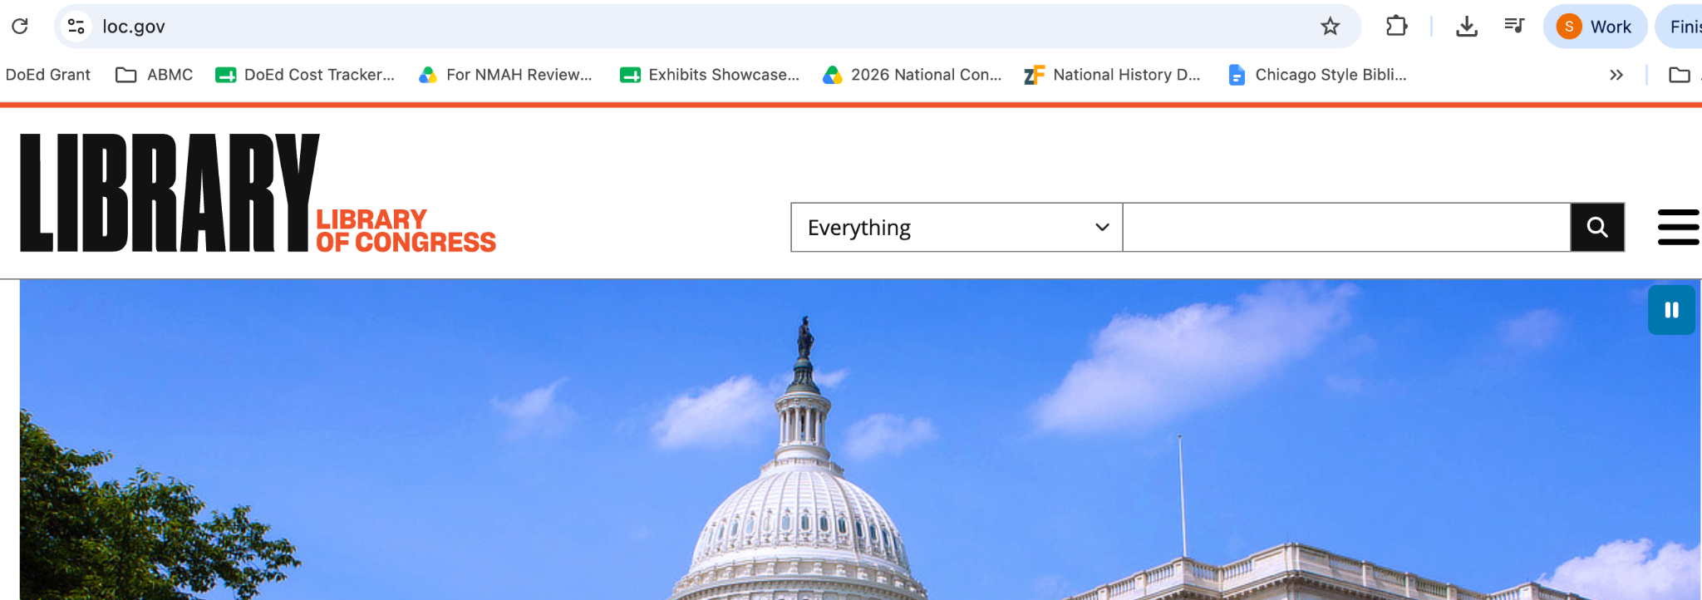
Searching the Library database - Key Word Search
loc.gov

Slide 24
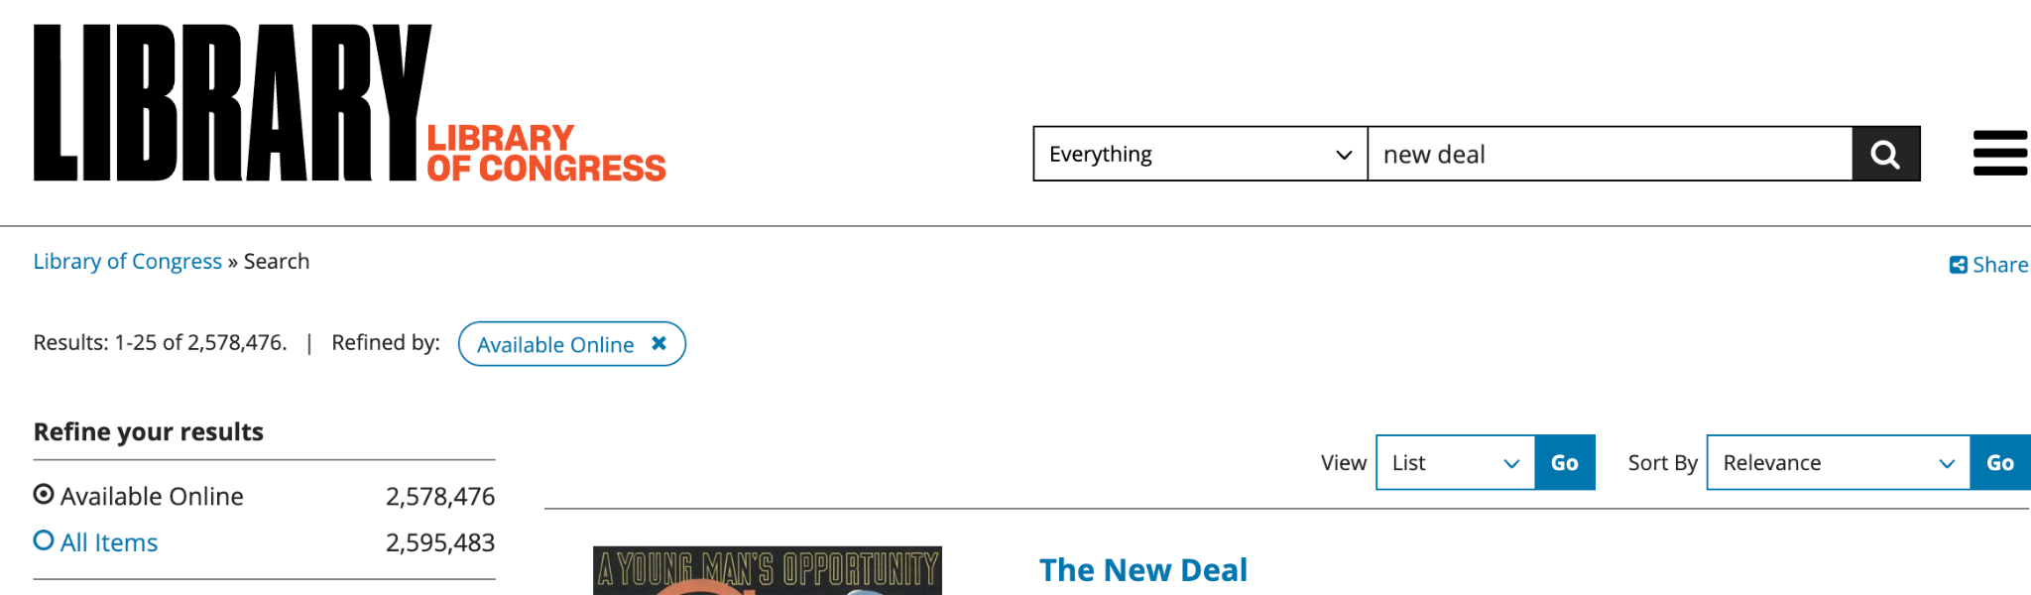
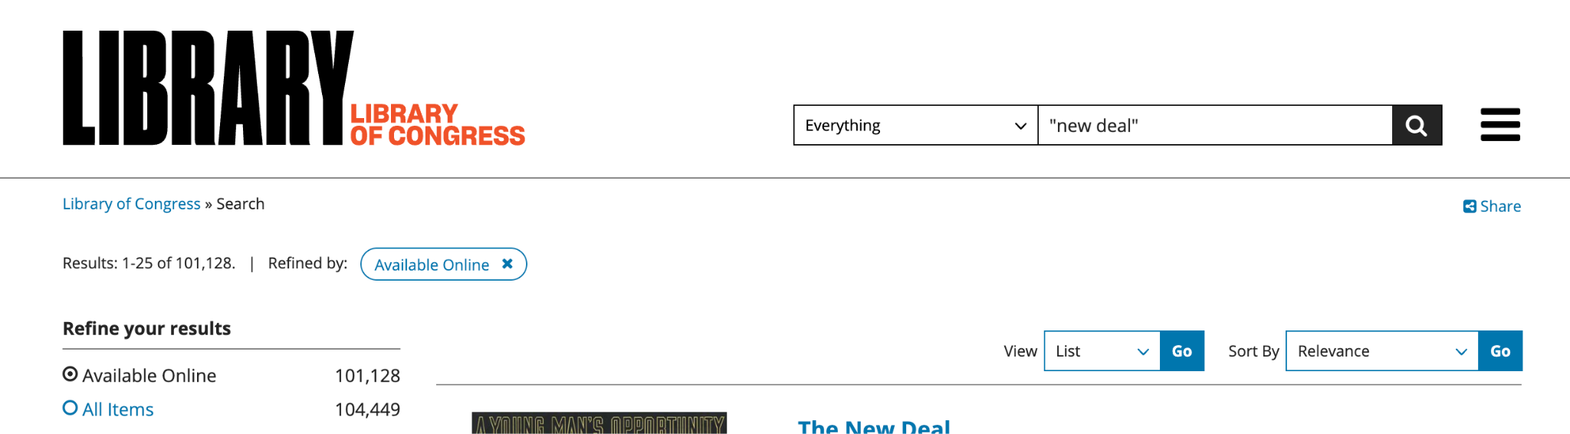
Searching the Library database - Tips
Use quotation marks!!!

Slide 25
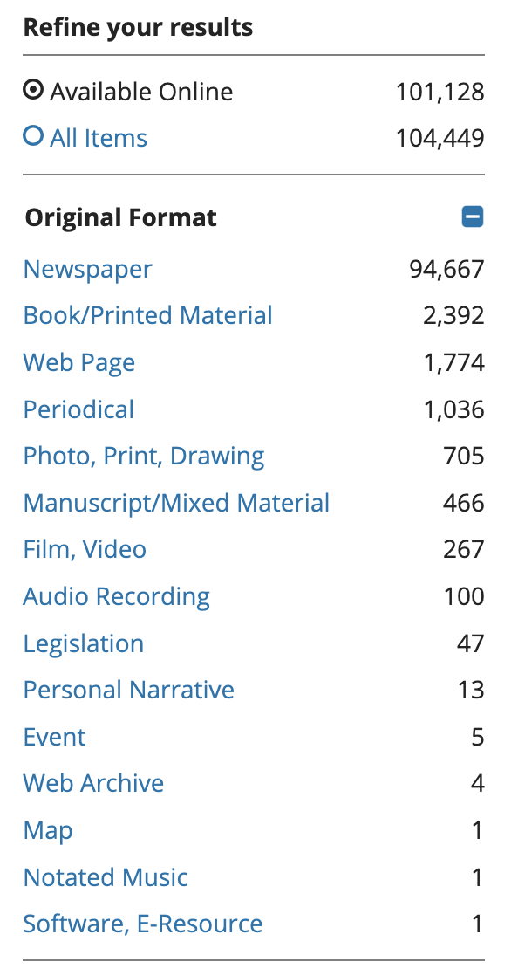
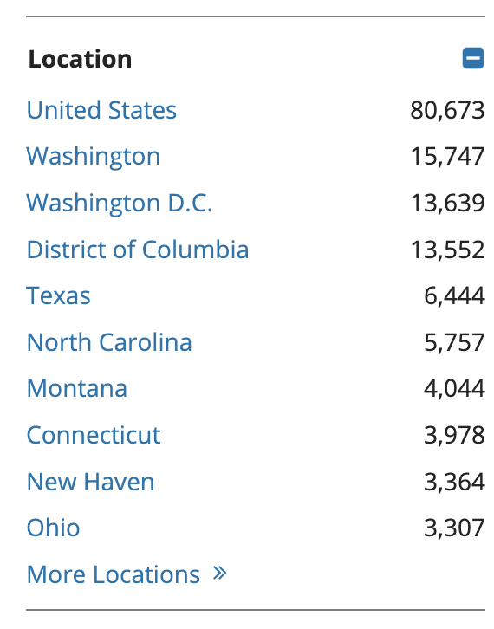
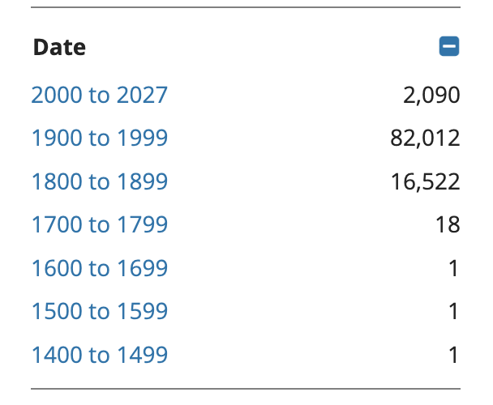
Searching the Library database - Tips
Use filters!

Slide 26
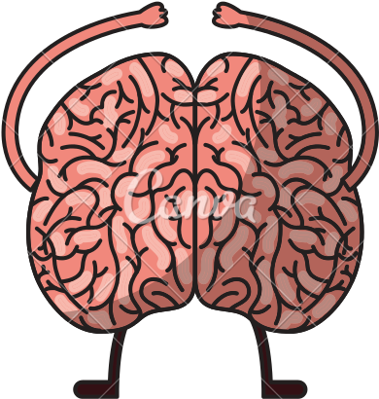
Searching the Library database - Activity
Start with the image you analyzed in the last activity
Keyword search on LOC
Find two (2) additional sources
Bonus for different formats!

Slide 27


Slide 28
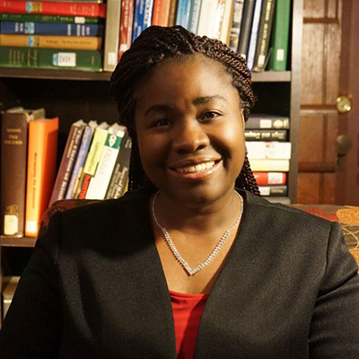
Connecticut Tobacco: Historical Context
Dr. Fiona Vernel
Associate Professor of History and Africana Studies, University of Connecticut

Slide 29
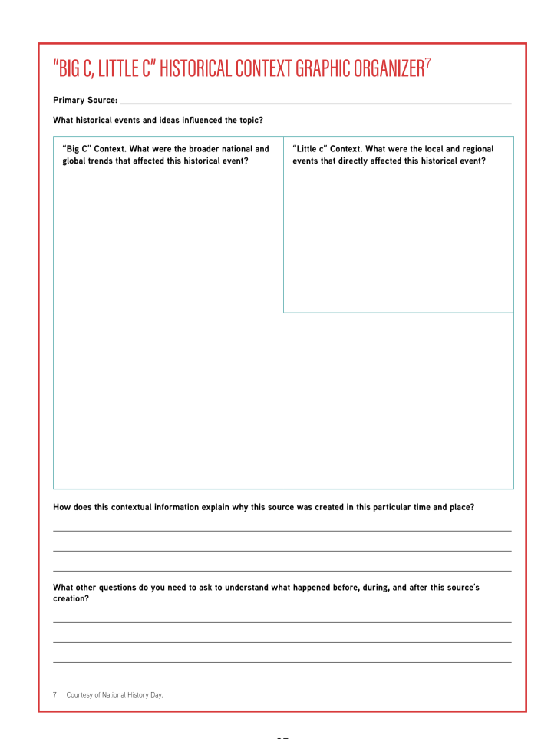
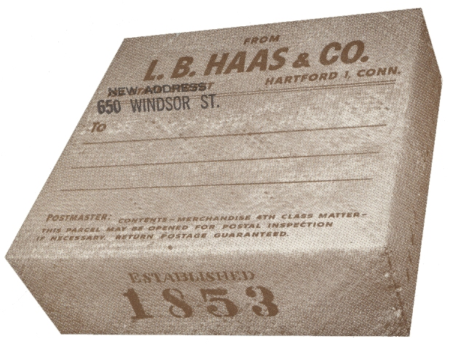
Connecticut Tobacco: Historical Context

Slide 30


ACTIVITY:
You be the Curator!
?
?
?

Slide 31
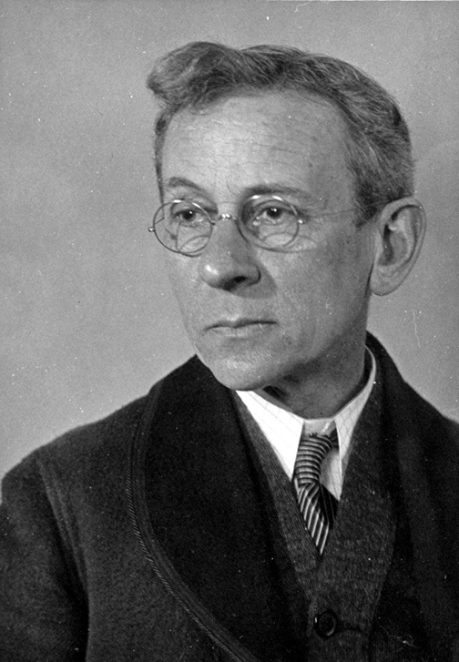
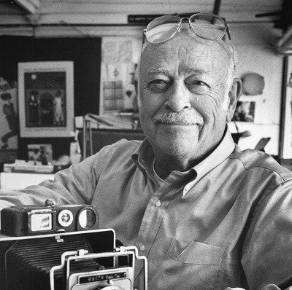
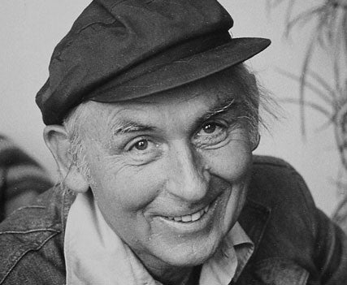

SOURCING
Notes:
Next, check the sources of the images you selected (on the back) - You can make changes to your curation based on the sources
Background on the photographers
Jack Delano - b 1914 Ukraine, immigrated 1923, studied in PA, worked for the photography projects of the Works Progress Administration, the United Fund, and the Farm Security Administration,
https://www.icp.org/browse/archive/constituents/jack-delano
Lewis W. Hine 1874-1940
Hine is best known for the documentary images of child labor practices that he produced under the aegis of the National Child Labor Committee from 1911 to 1916.

Slide 32
CONTEXT (Title)
Teaser
Notes:
what’s the title of your curated exhibit?
an

Slide 33
CLOSE READ (Caption)

Slide 34
Tell Us About Your Exhibits!

Slide 35
CONCLUSION
So what?

Slide 36

Materials: https://tinyurl.com/CT-PD-2026

Slide 37

Evaluation
URL and QR code for evaluation
This workshop is sponsored in part by the Library of Congress Teaching with Primary Sources Eastern Region Program, coordinated by Waynesburg University.

